Slide 1
PATTERN ART WORK - ANUSHA GUPTA

Slide 2
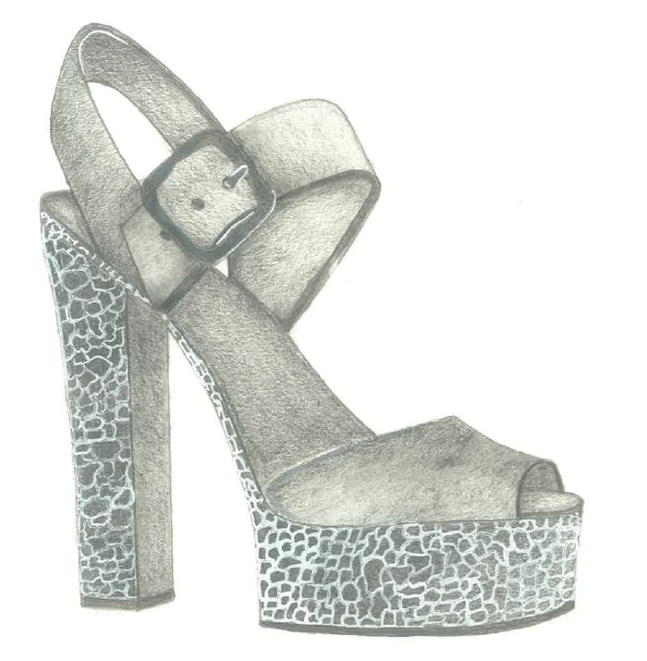

Slide 3
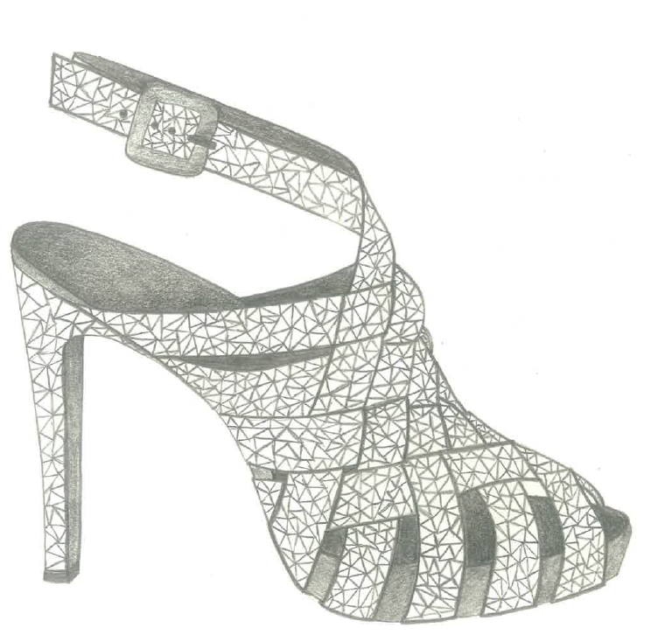

Slide 4
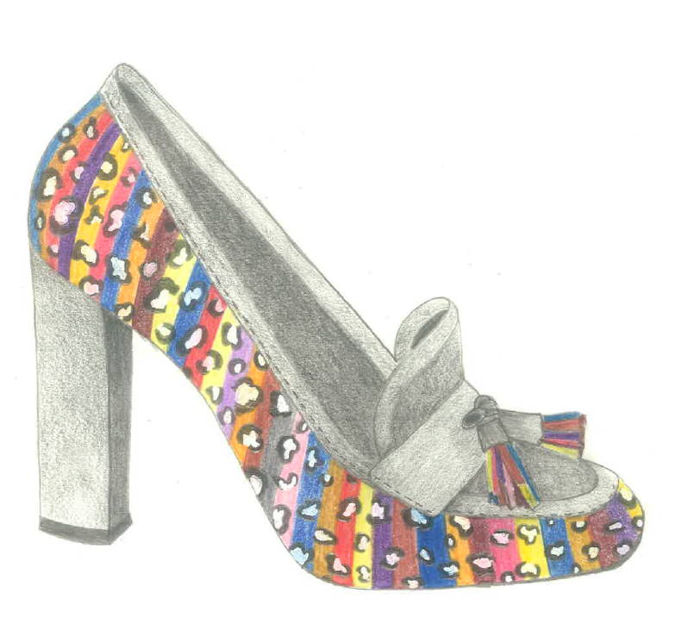

Slide 5
